Slide 1
Chapter 12: Exception Handling

Slide 2
Objectives – part 1
Learn about exceptions
Try code and catch exceptions
Throw and catch multiple exceptions
Use the finally block
Understand the advantages of exception handling

Slide 3
Objectives – part 2
Specify the exceptions that a method can throw
Trace exceptions through the call stack
Create your own Exception classes
Use an assertion

Slide 4
Learning About Exceptions – part 1
Exceptions
Unexpected or error conditions
Not usual occurrences
Causes:
The program issues a call to a file that does not exist
The program attempts to write to a full disk
The user enters invalid data
The program attempts to divide a value by 0

Slide 5
Learning About Exceptions – part 2
Exception handling
Object-oriented techniques used to manage Exception errors
Runtime exceptions
Exceptions
Objects
Descend from the Throwable class

Slide 6
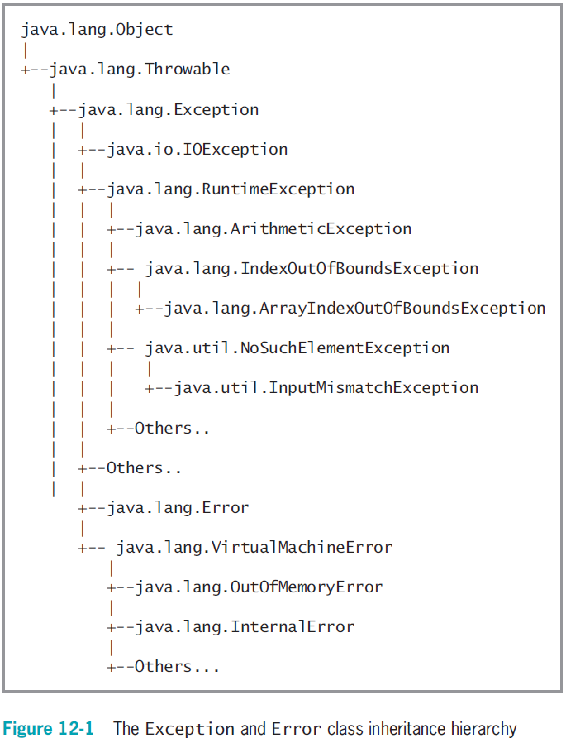
Figure 12-1 The Exception and Error class inheritance hierarchy

Slide 7
Learning About Exceptions – part 3
Error class
Represents serious errors from which a program usually cannot recover
Error condition
A program runs out of memory
A program cannot locate a required class

Slide 8
Learning About Exceptions – part 4
Exception class
Less serious errors
Unusual conditions
A program can recover from this type of error
Exception class errors
An invalid array subscript
Performing illegal arithmetic operations

Slide 9
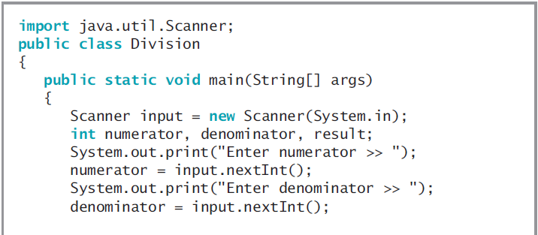
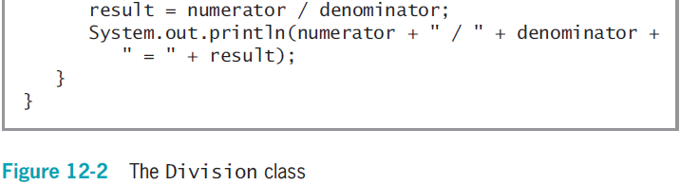
Learning About Exceptions – part 5

Slide 10
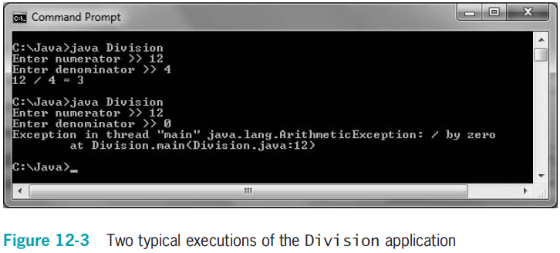
Learning About Exceptions – part 6

Slide 11
Learning About Exceptions – part 7
You do not necessarily have to deal with an exception
Let the offending program terminate
But doing so is abrupt and unforgiving
You can write programs without using exception-handling techniques
Use a decision to avoid an error
Exception handling provides a more elegant solution for handling error conditions

Slide 12
Learning About Exceptions – part 8
Fault-tolerant
Designed to continue to operate when some part of the system fails
Robustness
Represents the degree to which a system is resilient to stress

Slide 13
Trying Code and Catching Exceptions – part 1
try block
A segment of code in which something might go wrong
Attempts to execute
Acknowledges an exception might occur
A try block includes:
The keyword try
Opening and closing curly braces
Executable statements, which might cause an exception

Slide 14
Trying Code and Catching Exceptions – part 2
catch block
A segment of code
Immediately follows a try block
Handles an exception thrown by the try block preceding it
Can “catch” an Object of type Exception or an Exception child class
throw statement
Sends an Exception object out of a block or method so it can be handled elsewhere

Slide 15
Trying Code and Catching Exceptions – part 3
A catch block includes:
The keyword catch
Opening and closing parentheses
An Exception type
A name for an instance of the Exception type
Opening and closing curly braces
Statements to handle the error condition

Slide 16
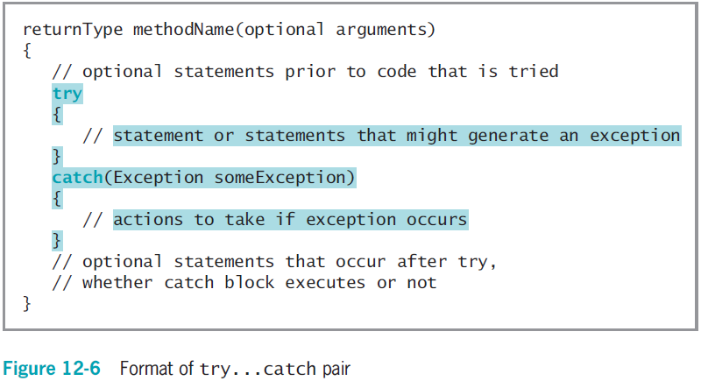
Trying Code and Catching Exceptions – part 4

Slide 17
Trying Code and Catching Exceptions – part 5
If no exception occurs within the try block, the catch block does not execute
getMessage() method
Obtains information about the exception
Within a catch block, you might want to add code to correct the error

Slide 18
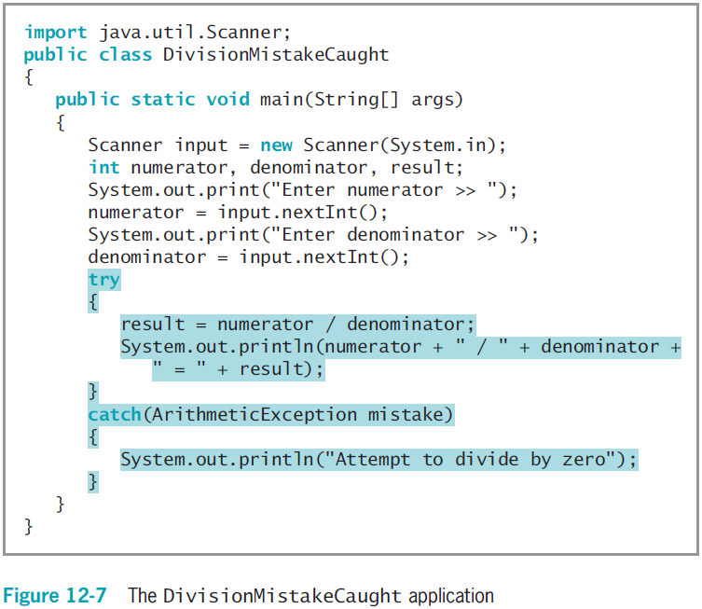
Trying Code and Catching Exceptions – part 6

Slide 19
Using a try Block to Make Programs “Foolproof” – part 1
It is useful to circumvent data entry errors
Handle potential data conversion exceptions caused by careless users
Using a nextLine() call will account for potential remaining characters in the input buffer

Slide 20
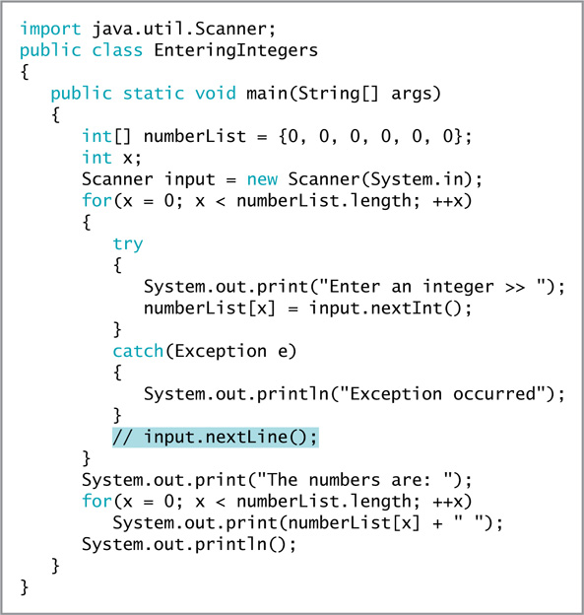
Using a try Block to Make Programs “Foolproof” – part 2
Figure 12-12 The EnteringIntegers program

Slide 21
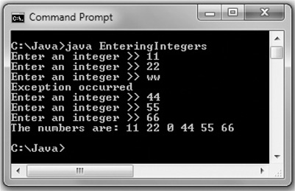
Using a try Block to Make Programs “Foolproof” – part 3
Figure 12-14 A typical execution of the EnteringIntegers program with the extra nextLine() call

Slide 22
Declaring and Initializing Variables in try…catch Blocks – part 1
A variable declared within a block is local to that block
It goes out of scope when the try or catch block ends
If the conversion fails, an exception is thrown

Slide 23
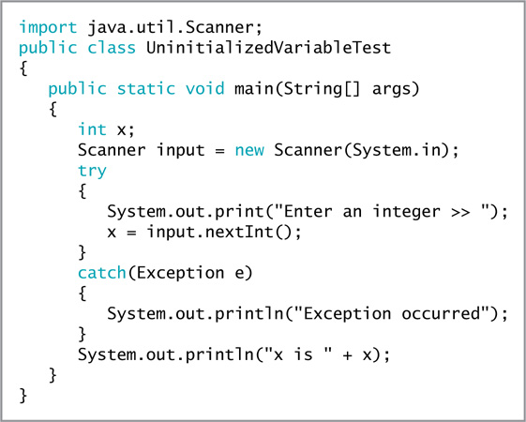
Declaring and Initializing Variables in try…catch Blocks – part 2
Figure 12-15 The UninitializedVariableTest program

Slide 24
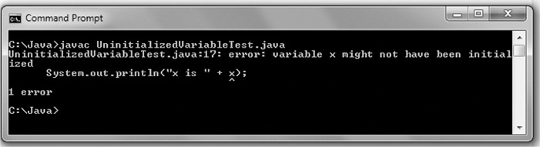
Declaring and Initializing Variables in try…catch Blocks – part 3
Figure 12-16 The error message generated when compiling the UninitializedVariableTest program

Slide 25
Throwing and Catching Multiple Exceptions – part 1
You can place multiple statements within a try block
Only the first error-generating statement throws an exception
When a program contains multiple catch blocks:
They are examined in sequence until a match is found for the Exception type
The matching catch block executes
Each remaining catch block is bypassed

Slide 26
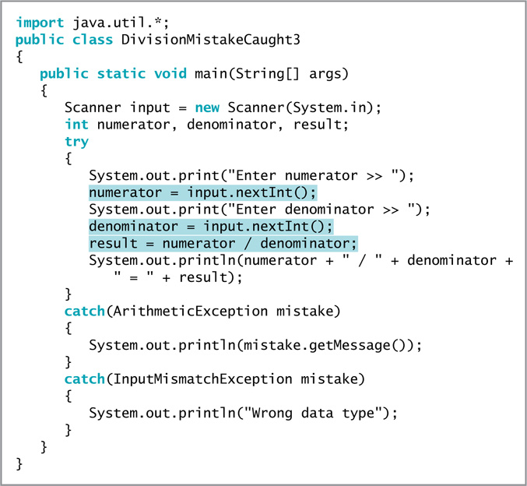
Figure 12-18 The DivisionMistakeCaught3 class

Slide 27
Throwing and Catching Multiple Exceptions – part 2
“Catch-all” block
Accepts a more generic Exception argument type:
catch(Exception e)
Unreachable code
Program statements that can never execute under any circumstances
In Java 7, a catch block can also be written to catch multiple Exception types
It is poor style for a method to throw more than three or four Exception types

Slide 28
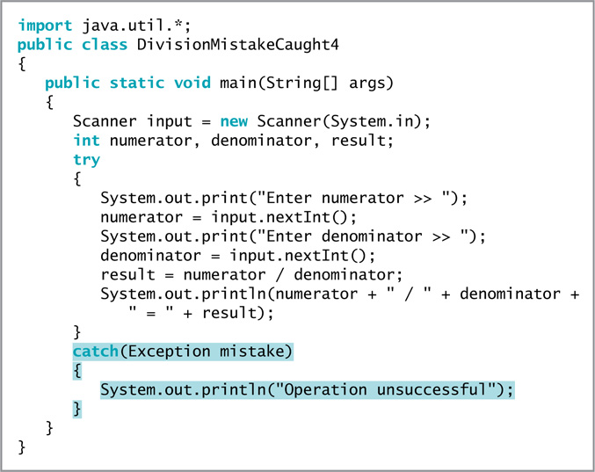
Figure 12-20 The DivisionMistakeCaught4 application

Slide 29
Using the finally Block – part 1
finally block
Use for actions you must perform at the end of a try…catch sequence
Use to perform cleanup tasks
Executes regardless of whether the preceding try block identifies an exception

Slide 30
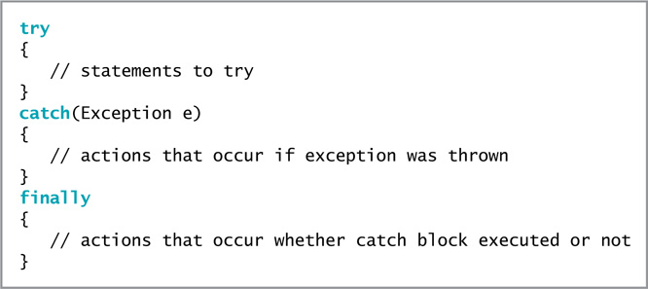
Using the finally Block – part 2
Figure 12-24 Format of try…catch…finally sequence

Slide 31
Using the finally Block – part 3
When the try code fails:
It throws an exception
The Exception object is caught
The catch block executes
Control passes to statements at the end of the method

Slide 32
Using the finally Block – part 4
Reasons the final set of statements might never execute:
An unplanned exception might occur
The try or catch block might contain a System.exit(); statement
The try block might throw an Exception object for which you did not provide a catch block
Program execution stops immediately
The exception is sent to the operating system for handling
The current method is abandoned

Slide 33
Using the finally Block – part 5
When the finally block is used, finally statements execute before the method is abandoned
The finally block executes no matter what outcome of the try block occurs
The try ends normally
The catch executes
The exception causes the method to abandon prematurely

Slide 34
Understanding the Advantages of Exception Handling – part 1
Before object-oriented programming languages, errors were handled with confusing, error-prone methods
When any method fails, the program sets appropriate error code
Difficult to follow
The application’s purpose and intended outcome are lost in a maze of if statements
Coding mistakes are made because of complicated nesting

Slide 35
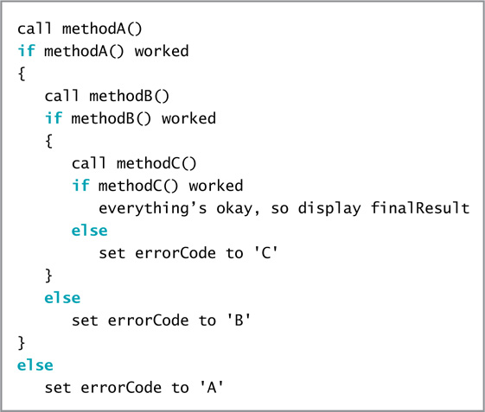
Understanding the Advantages of Exception Handling – part 2
Figure 12-26 Pseudocode representing traditional error checking

Slide 36
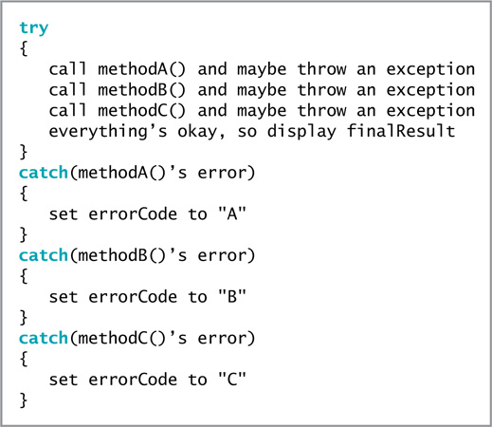
Understanding the Advantages of Exception Handling – part 3
Figure 12-27 Pseudocode representing object-oriented exception handling
Java Programming, Seventh Edition

Slide 37
Understanding the Advantages of Exception Handling – part 4
Java’s object-oriented, error-handling technique
Statements of the program that do the “real” work are placed together, where their logic is easy to follow
Unusual, exceptional events are grouped and moved out of the way
An advantage to object-oriented exception handling is flexibility in handling of error situations
Appropriately deal with exceptions as you decide how to handle them

Slide 38
Specifying the Exceptions That a Method Can Throw – part 1
If a method throws an exception that it will not catch but will be caught by a different method, use the keyword throws followed by the Exception type in the method header
Exception specification
Lists exceptions that a method may throw
Every Java method has the potential to throw an exception
For most Java methods, do not use the throws clause
Let Java handle any exception by shutting down the program
Most exceptions never have to be explicitly thrown or caught

Slide 39
Specifying the Exceptions That a Method Can Throw – part 2
Checked exceptions
Programmers should anticipate checked exceptions
Programs should be able to recover from them
Unchecked exceptions
Inherit from the Error class or the RuntimeException class
You are not required to handle these exceptions
You can simply let the program terminate
An example is dividing by zero

Slide 40
Specifying the Exceptions That a Method Can Throw – part 3
If you throw a checked exception from a method, you must do one of the following:
Catch it
Declare the exception in the method header’s throws clause
To use a method to its full potential, you must know the:
Method’s name
Method’s return type
Type and number of arguments the method requires
Type and number of exceptions the method throws

Slide 41
Tracing Exceptions Through the Call Stack – part 1
Call stack
The memory location where the computer stores the list of method locations to which the system must return
When a method throws an exception:
The exception is thrown to the next method up the call stack
Methods are allowed to handle exceptions wherever the programmer has decided it is most appropriate
Including allowing the operating system to handle the error

Slide 42
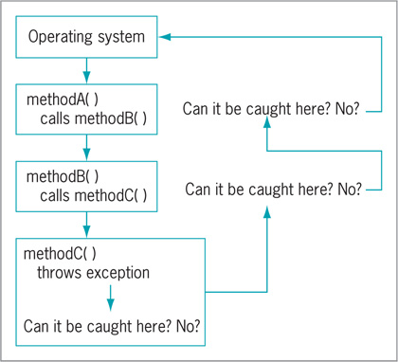
Tracing Exceptions Through the Call Stack – part 2
Figure 12-32 Cycling through the call stack

Slide 43
Tracing Exceptions Through the Call Stack – part 3
printStackTrace() method
Displays a list of methods in the call stack
Determines the location of an exception
Do not place in a finished program
Most useful for diagnosing problems

Slide 44
Creating Your Own Exception Classes
Java provides over 40 categories of Exceptions
Java allows you to create your own Exception classes
Extend a subclass of Throwable
Exception class constructors:
Exception()
Exception(String message)
Exception(String message, Throwable cause)
Exception(Throwable cause)

Slide 45
Using Assertions – part 1
Assertion
A Java language feature
Detects logic errors
Debugs programs
assert statement
Creates an assertion, such as:
assert booleanExpression : optionalErrorMessage
The Boolean expression in the assert statement should always be true if the program is working correctly

Slide 46
Using Assertions – part 2
An AssertionError is thrown when a condition is false
To enable an assertion, you must use the -ea option when executing a program

Slide 47
You Do It
Throwing and Catching an Exception
Using Multiple catch Blocks
Creating a Class That Automatically Throws Exceptions
Creating a Class That Passes on an Exception Object
Creating an Application That Can Catch Exceptions
Extending a Class That Throws Exceptions
Creating an Exception Class
Using an Exception You Created

Slide 48
Don’t Do It – part 1
Don’t forget that all the statements in a try block might not execute
Don’t forget you might need a nextLine() method call after an attempt to read numeric data from the keyboard throws an exception
Don’t forget that a variable declared in a try block goes out of scope at the end of the block
Don’t forget that when a variables get its usable value within a try block, you must ensure that it has a valid value before attempting to use it

Slide 49
Don’t Do It – part 2
Don’t forget to place more specific catch blocks before more general ones
Don’t forget to write a throws clause for a method that throws an exception but does not handle it
Don’t forget to handle any checked exception thrown to your method

Slide 50
Summary – part 1
Exception
An unexpected or error condition
Exception handling
Object-oriented techniques to manage errors
Basic classes of errors: Error and Exception
Exception-handling code
try block
catch block
finally block

Slide 51
Summary – part 2
Use the throws <name>Exception clause after the method header
Indicate the type of exception that might be thrown
Call stack
A list of method locations to which the system must return
Java provides over 40 categories of Exceptions
Create your own Exception classes
Assertion
State a condition that should be true
Java throws an AssertionError when it is not

